Slide 1
PSES Dataset 2019 Data-fest 2020
This presentation determines and displays significant areas of strength and weaknesses within the department and shares best practices for management improvement.
Contributed by: Neethu, Khalid, Nada, Nilesh, Anjali

Slide 2
Introduction | Public Service Employee Survey
Literature Survey
Objective: To provide information to support the continuous improvement of people management practices in the federal public service.
Summary: This survey aims at measuring federal government employees’ opinions about their engagement, leadership, workforce, workplace, workplace well-being and compensation.
Data
Summary: The 2019 Public Service Employee Survey was conducted from July 22 to September 6, 2019
Number of Employees
182,306
Federal Departments
86
Response Rate
62.3%
Data Usage:
The 2019 Public Service Employee Survey 2019 dataset, focused on the Federal Department ‘Innovation, Science and Economic Development Canada (ISED)’.

Slide 3
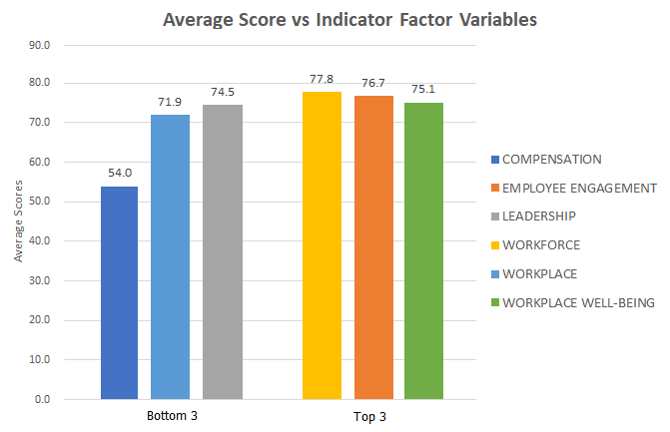
Key Findings
Variable Selection for Analysis:
Top 3 (High Scores):
Workforce
Employee Engagement
Workplace well-being
Bottom 3 (Least Score):
Compensation
Workplace
Leadership

Slide 4
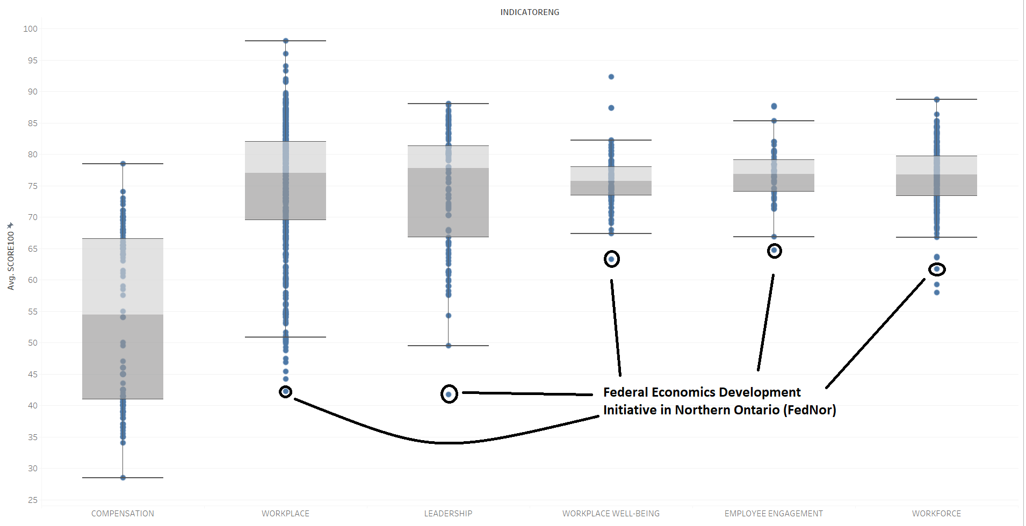
Outlier Detection by Exploratory Data Analysis

Slide 5
Exploratory Data Analysis (Continued)
Average Scores | WORKPLACE |  | LEADERSHIP
Low Score | 69.5% | Federal Economic Development Initiative in Northern Ontario | 56.8% | Federal Economic Development Initiative in Northern Ontario(FedNor)
 | Employees rated low for Organizational Performance |  | Rated low for ambiguity in communication from Upper Management to Lower Hierarchy.
High Score | 79.6% | Aggregate of Science & Research Sectors | 84.6% | Governance and Corporate Management Branch
 | Employees rated high for flexibility in Usage of official languages |  | Employees rate high due to Encouragement from Immediate Supervisor. Collaboration outside work.

Slide 6
Key Insights

Slide 7
Recommendations
Flexibility in Work Schedule
Bridge hierarchical communication gap between senior management and staff
Promote a sense of belongingness through a better work environment
Improve Workplace Infrastructure

